Slide 1
Quadratic Segments

Slide 2
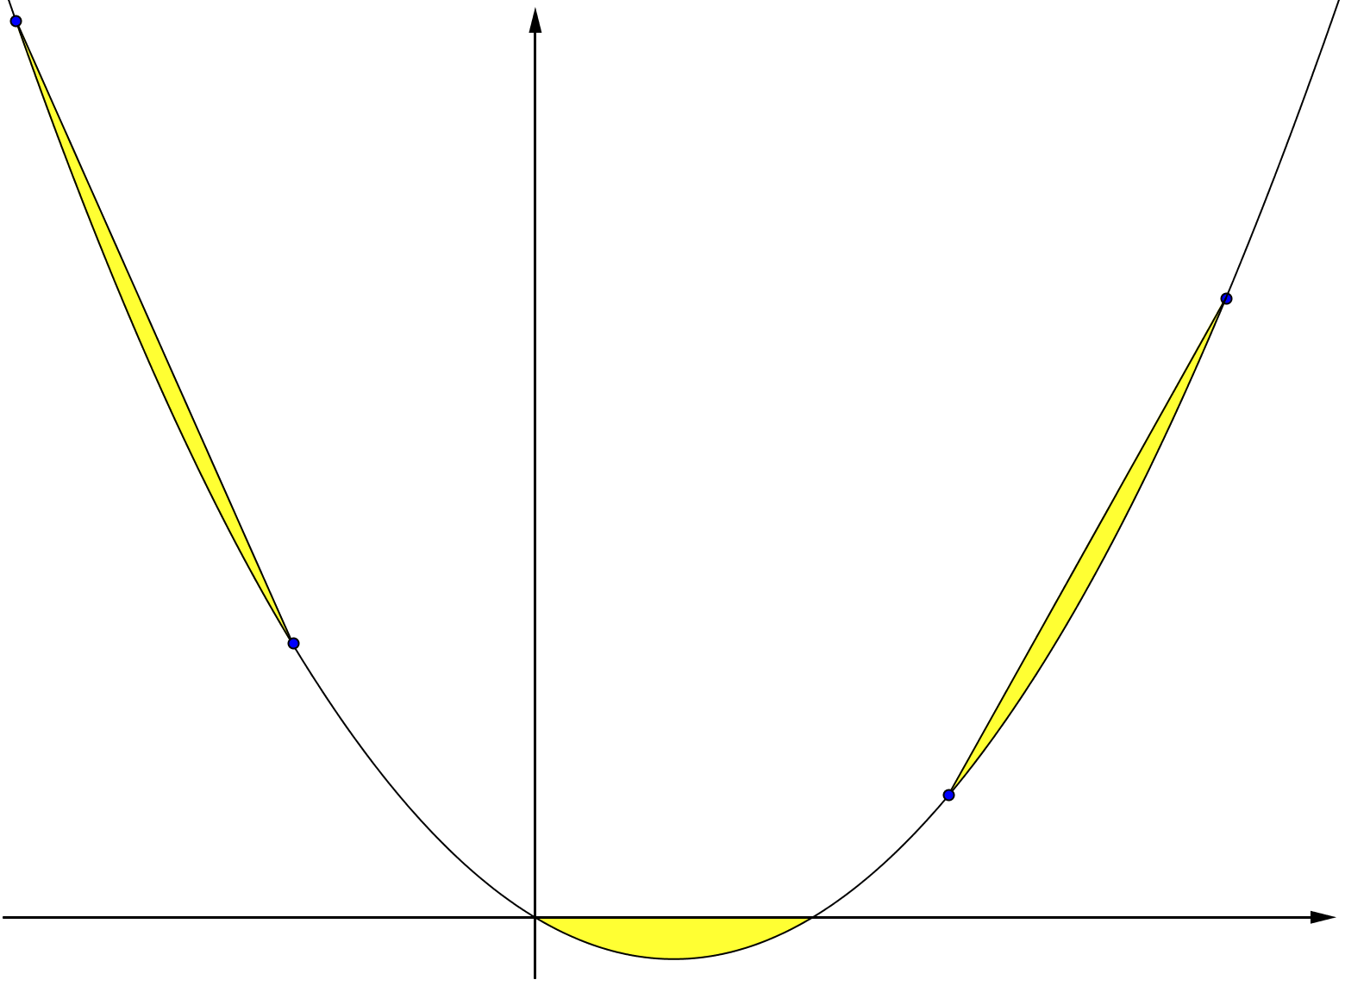










Quadratic Segments
$$y$$
$$C \left(x=−7\right)$$
parabola
$$3$$
Calculate the areas of the segments
1, 2 and 3
$$B \left(x=6\right)$$
$$2$$
$$\left(x=−5\right) D$$
$$A \left(4,24\right)$$
$$1$$
$$x$$
$$2$$
(Not to scale)

Slide 3
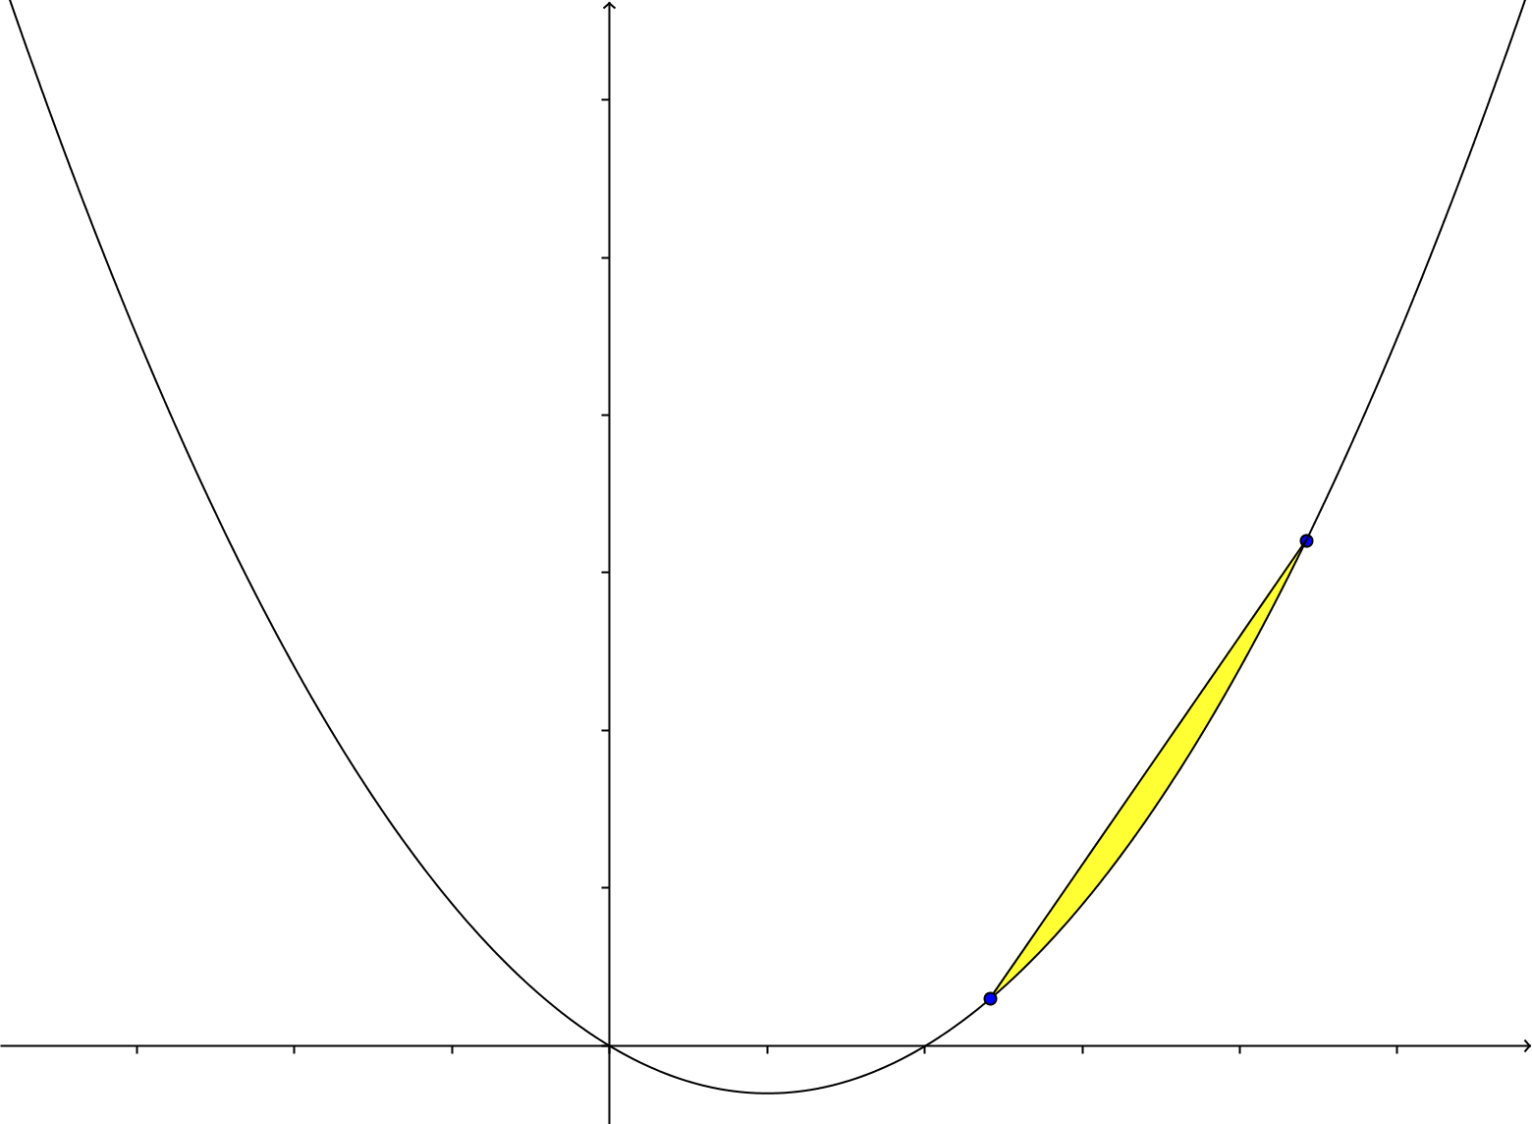




Quadratic Segments
$$y=ax^{2}+bx+c$$
Let’s look at the general case.
$$x=p+L$$
$$L$$
$$x=p$$

Slide 4
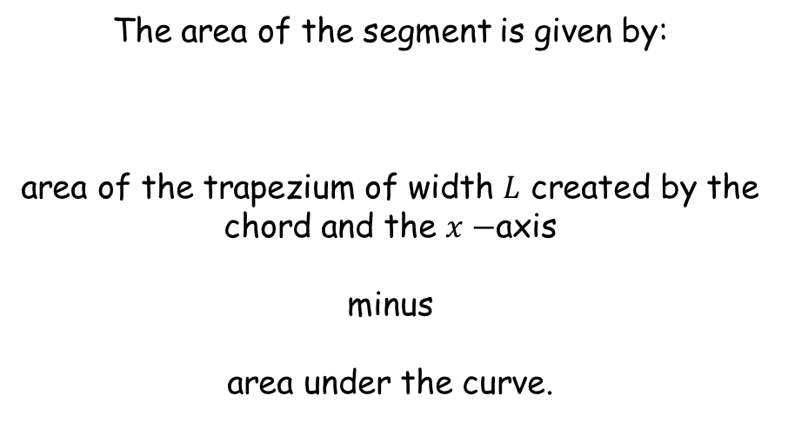
Quadratic Segments
The area of the segment is given by:
area of the trapezium of width $L$ created by the chord and the $x−$axis
minus
area under the curve.

Slide 5
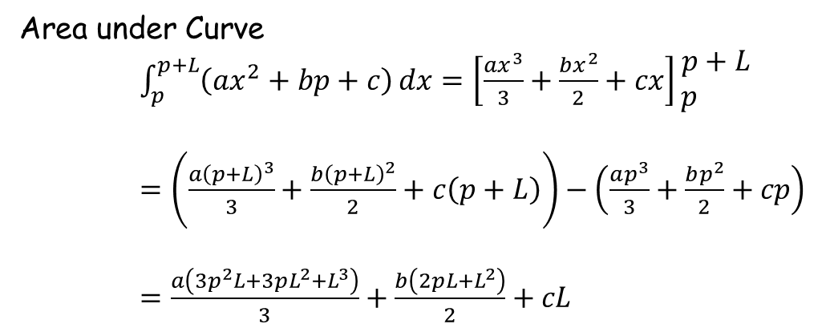
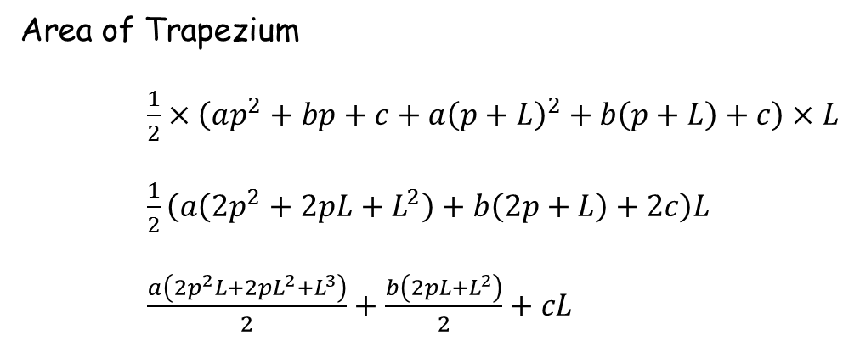
Quadratic Segments
Area of Trapezium
$\frac{1}{2}×\left(ap^{2}+bp+c+a{\left(p+L\right)}^{2}+b\left(p+L\right)+c\right)×L$
$\frac{1}{2}\left(a\left({2p}^{2}+2pL+L^{2}\right)+b\left(2p+L\right)+2c\right)L$
$\frac{a\left(2p^{2}L+2pL^{2}+L^{3}\right)}{2}+\frac{b\left(2pL+L^{2}\right)}{2}+cL$
Area under Curve
$\int_{p}^{p+L}{\left(ax^{2}+bp+c\right)}dx=\left[\frac{ax^{3}}{3}+\frac{bx^{2}}{2}+cx\right]\begin{matrix}p+L \\ p \end{matrix}$
$=\left(\frac{a{\left(p+L\right)}^{3}}{3}+\frac{b{\left(p+L\right)}^{2}}{2}+c\left(p+L\right)\right)−\left(\frac{ap^{3}}{3}+\frac{bp^{2}}{2}+cp\right)$
$=\frac{a\left(3p^{2}L+3pL^{2}+L^{3}\right)}{3}+\frac{b\left(2pL+L^{2}\right)}{2}+cL$

Slide 6
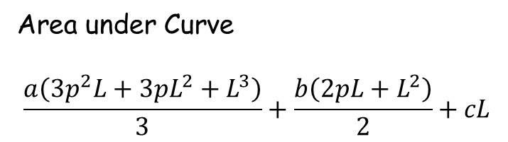
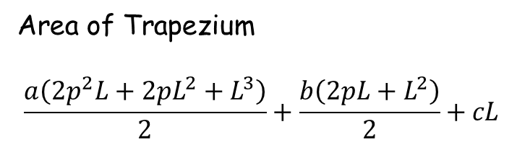
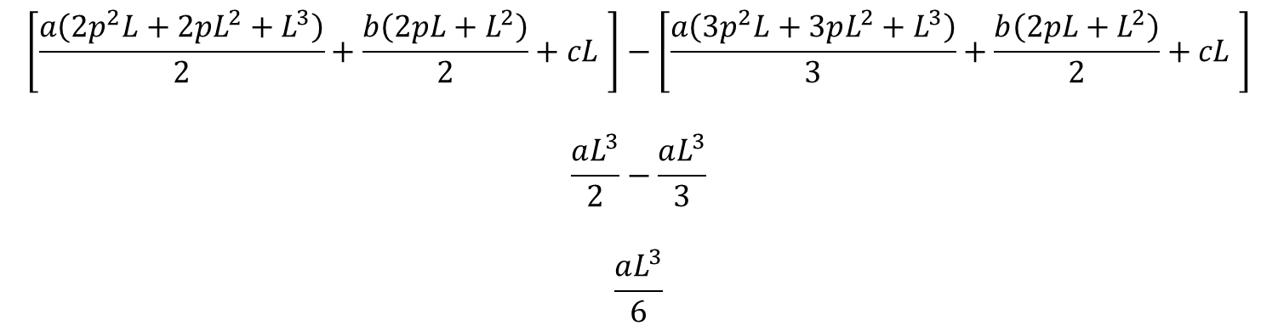
Quadratic Segments
Area of Trapezium
$$\frac{a\left(2p^{2}L+2pL^{2}+L^{3}\right)}{2}+\frac{b\left(2pL+L^{2}\right)}{2}+cL$$
Area under Curve
$$\frac{a\left(3p^{2}L+3pL^{2}+L^{3}\right)}{3}+\frac{b\left(2pL+L^{2}\right)}{2}+cL$$
Area of Segment
$$\left[\frac{a\left(2p^{2}L+2pL^{2}+L^{3}\right)}{2}+\frac{b\left(2pL+L^{2}\right)}{2}+cL \right]−\left[\frac{a\left(3p^{2}L+3pL^{2}+L^{3}\right)}{3}+\frac{b\left(2pL+L^{2}\right)}{2}+cL \right]$$
$$\frac{aL^{3}}{2}−\frac{aL^{3}}{3}$$
$$\frac{aL^{3}}{6}$$

Slide 7
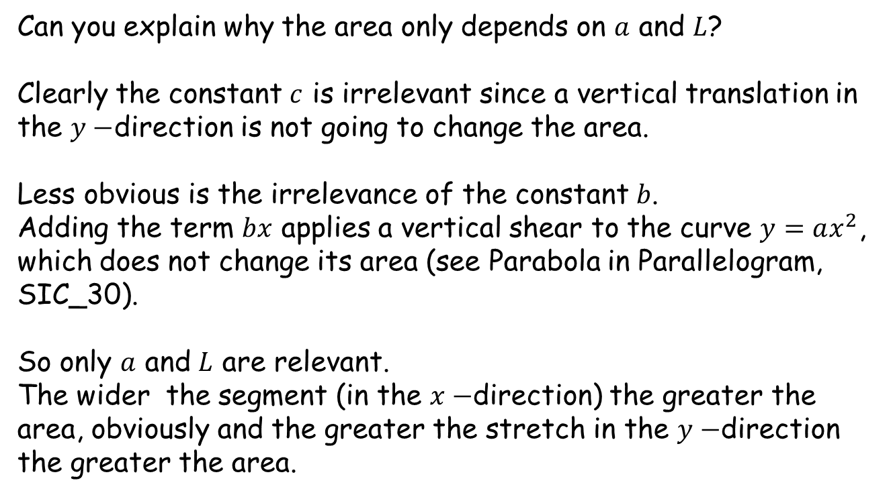
Quadratic Segments
Can you explain why the area only depends on $a$ and $L$?
Clearly the constant $c$ is irrelevant since a vertical translation in the $y−$direction is not going to change the area.
Less obvious is the irrelevance of the constant $b$.
Adding the term $bx$ applies a vertical shear to the curve $y=ax^{2}$, which does not change its area (see Parabola in Parallelogram, SIC_30).
So only $a$ and $L$ are relevant.
The wider the segment (in the $x−$direction) the greater the area, obviously and the greater the stretch in the $y−$direction the greater the area.

Slide 9
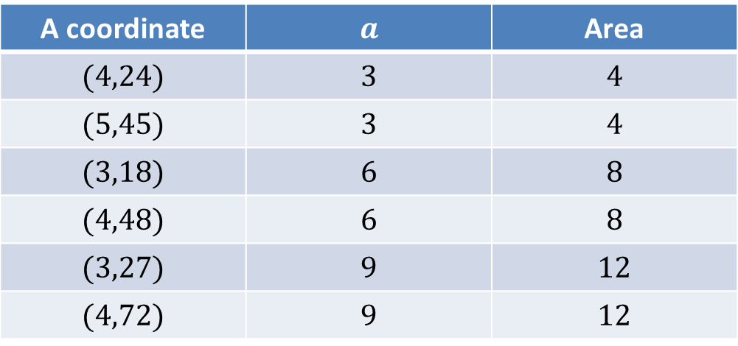
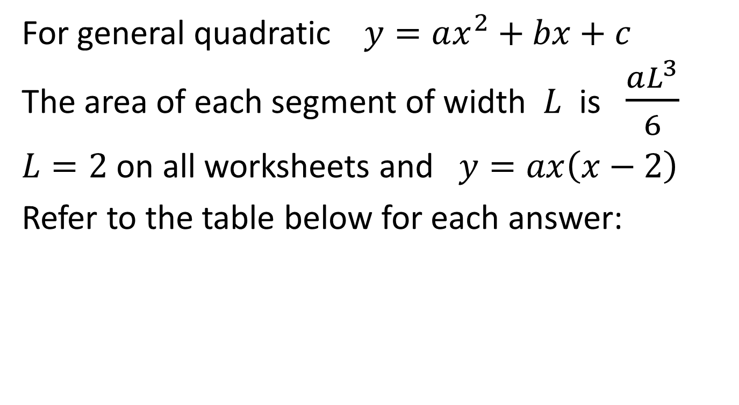
Note to Teacher
For general quadratic $y=ax^{2}+bx+c$
The area of each segment of width $L$ is $\frac{aL^{3}}{6}$
$L=2$ on all worksheets and $y=ax\left(x−2\right)$
Refer to the table below for each answer:
A coordinate | $$a$$ | Area
$$(4,24)$$ | $$3$$ | $$4$$
$$(5,45)$$ | $$3$$ | $$4$$
$$(3,18)$$ | $$6$$ | $$8$$
$$(4,48)$$ | $$6$$ | $$8$$
$$(3,27)$$ | $$9$$ | $$12$$
$$(4,72)$$ | $$9$$ | $$12$$

Slide 10
RESOURCES

Slide 11
Quadratic Segments
SIC_40
$$y$$
$$C \left(x=−7\right)$$
parabola
$$3$$
Calculate the areas of the segments
1, 2 and 3
$$B \left(x=6\right)$$
$$2$$
$$\left(x=−5\right) D$$
$$A \left(4,24\right)$$
$$1$$
$$x$$
$$2$$
(Not to scale)

Slide 12


SIC_40
Quadratic Segments
$$y$$
$$C \left(x=−5\right)$$
parabola
$$3$$
Calculate the areas of the segments
1, 2 and 3
$$B \left(x=6\right)$$
$$2$$
$$\left(x=−3\right) D$$
$$A \left(4,24\right)$$
$$1$$
$$x$$
$$2$$
(Not to scale)

Slide 13


SIC_40
Quadratic Segments
$$y$$
$$C \left(x=−3\right)$$
parabola
$$3$$
Calculate the areas of the segments
1, 2 and 3
$$B \left(x=6\right)$$
$$2$$
$$\left(x=−1\right) D$$
$$A \left(4,24\right)$$
$$1$$
$$x$$
$$2$$
(Not to scale)

Slide 14


SIC_40
Quadratic Segments
$$y$$
$$C \left(x=−3\right)$$
parabola
$$3$$
Calculate the areas of the segments
1, 2 and 3
$$B \left(x=7\right)$$
$$2$$
$$\left(x=−1\right) D$$
$$A \left(5,45\right)$$
$$1$$
$$x$$
$$2$$
(Not to scale)

Slide 15
SIC_40
Quadratic Segments
$$y$$
$$C \left(x=−5\right)$$
parabola
$$3$$
Calculate the areas of the segments
1, 2 and 3
$$B \left(x=7\right)$$
$$2$$
$$\left(x=−3\right) D$$
$$A \left(5,45\right)$$
$$1$$
$$x$$
$$2$$
(Not to scale)

Slide 16


SIC_40
Quadratic Segments
$$y$$
$$C \left(x=−6\right)$$
parabola
$$3$$
Calculate the areas of the segments
1, 2 and 3
$$B \left(x=7\right)$$
$$2$$
$$\left(x=−4\right) D$$
$$A \left(5,45\right)$$
$$1$$
$$x$$
$$2$$
(Not to scale)

Slide 17


SIC_40
Quadratic Segments
$$y$$
$$C \left(x=−6\right)$$
parabola
$$3$$
Calculate the areas of the segments
1, 2 and 3
$$B \left(x=5\right)$$
$$2$$
$$\left(x=−4\right) D$$
$$A \left(3,18\right)$$
$$1$$
$$x$$
$$2$$
(Not to scale)

Slide 18


SIC_40
Quadratic Segments
$$y$$
$$C \left(x=−4\right)$$
parabola
$$3$$
Calculate the areas of the segments
1, 2 and 3
$$B \left(x=5\right)$$
$$2$$
$$\left(x=−2\right) D$$
$$A \left(3,18\right)$$
$$1$$
$$x$$
$$2$$
(Not to scale)

Slide 19
SIC_40
Quadratic Segments
$$y$$
$$C \left(x=−3\right)$$
parabola
$$3$$
Calculate the areas of the segments
1, 2 and 3
$$B \left(x=5\right)$$
$$2$$
$$\left(x=−1\right) D$$
$$A \left(3,18\right)$$
$$1$$
$$x$$
$$2$$
(Not to scale)

Slide 20

SIC_40
Quadratic Segments
$$y$$
$$C \left(x=−3\right)$$
parabola
$$3$$
Calculate the areas of the segments
1, 2 and 3
$$B \left(x=6\right)$$
$$2$$
$$\left(x=−1\right) D$$
$$A \left(4,48\right)$$
$$1$$
$$x$$
$$2$$
(Not to scale)

Slide 21
SIC_40
Quadratic Segments
$$y$$
$$C \left(x=−5\right)$$
parabola
$$3$$
Calculate the areas of the segments
1, 2 and 3
$$B \left(x=6\right)$$
$$2$$
$$\left(x=−3\right) D$$
$$A \left(4,48\right)$$
$$1$$
$$x$$
$$2$$
(Not to scale)

Slide 22
SIC_40
Quadratic Segments
$$y$$
$$C \left(x=−4\right)$$
parabola
$$3$$
Calculate the areas of the segments
1, 2 and 3
$$B \left(x=6\right)$$
$$2$$
$$\left(x=−2\right) D$$
$$A \left(4,48\right)$$
$$1$$
$$x$$
$$2$$
(Not to scale)

Slide 23

SIC_40
Quadratic Segments
$$y$$
$$C \left(x=−4\right)$$
parabola
$$3$$
Calculate the areas of the segments
1, 2 and 3
$$B \left(x=5\right)$$
$$2$$
$$\left(x=−2\right) D$$
$$A \left(3,27\right)$$
$$1$$
$$x$$
$$2$$
(Not to scale)

Slide 24
SIC_40
Quadratic Segments
$$y$$
$$C \left(x=−6\right)$$
parabola
$$3$$
Calculate the areas of the segments
1, 2 and 3
$$B \left(x=5\right)$$
$$2$$
$$\left(x=−4\right) D$$
$$A \left(3,27\right)$$
$$1$$
$$x$$
$$2$$
(Not to scale)

Slide 25
SIC_40
Quadratic Segments
$$y$$
$$C \left(x=−7\right)$$
parabola
$$3$$
Calculate the areas of the segments
1, 2 and 3
$$B \left(x=5\right)$$
$$2$$
$$\left(x=−5\right) D$$
$$A \left(3,27\right)$$
$$1$$
$$x$$
$$2$$
(Not to scale)

Slide 26

SIC_40
Quadratic Segments
$$y$$
$$C \left(x=−7\right)$$
parabola
$$3$$
Calculate the areas of the segments
1, 2 and 3
$$B \left(x=6\right)$$
$$2$$
$$\left(x=−5\right) D$$
$$A \left(4,72\right)$$
$$1$$
$$x$$
$$2$$
(Not to scale)

Slide 27
SIC_40
Quadratic Segments
$$y$$
$$C \left(x=−5\right)$$
parabola
$$3$$
Calculate the areas of the segments
1, 2 and 3
$$B \left(x=6\right)$$
$$2$$
$$\left(x=−3\right) D$$
$$A \left(4,72\right)$$
$$1$$
$$x$$
$$2$$
(Not to scale)

Slide 28
SIC_40
Quadratic Segments
$$y$$
$$C \left(x=−3\right)$$
parabola
$$3$$
Calculate the areas of the segments
1, 2 and 3
$$B \left(x=6\right)$$
$$2$$
$$\left(x=−1\right) D$$
$$A \left(4,72\right)$$
$$1$$
$$x$$
$$2$$
(Not to scale)

